Slide 2
Presentation Outline
Abstract
Introduction
Background, Justification
Literature Review
What’s been done? What are the gaps? Problem Statement, Main objective, Specific objective
Proposed Methodology
Expected outcomes
To include a proposed budget and time plan
Conclusion:
Notes:
25-Aug-22
1

Slide 3
ABSTRACT
Environmental friendly power sources
Scarcity of fossil fuel
High demand of clean energy
Reduction of production cost
Emergence of large wind turbines
Reduction of structural load
[http://www.iea.org/]
[http://www.effectofglobalwarming.com/]

Slide 4
Outline
Motivation
Introduction
Wind turbine model
Linearization
Multi-blade coordinate transformation
Multivariable control strategy for high wind speed region
Multi-objective control strategy for partial load region
Lifetime extension scheme
Summary, conclusion, and outlook
Notes:
25-Aug-22
3

Slide 5
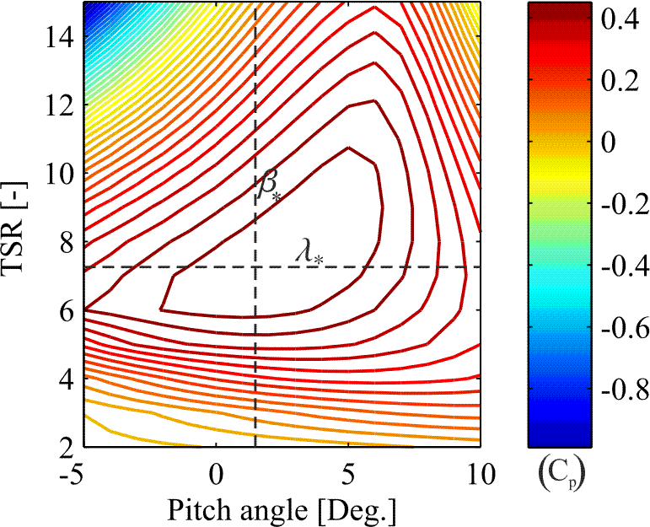

Introduction: Overview
Wind power harvesting
Available wind power
Etc
[Njiri, Söffker, 2016]
: Wind speed
: Rotor radius
: Power coefficient
: Rotation speed
: Air density
: Pitch angle

Slide 6
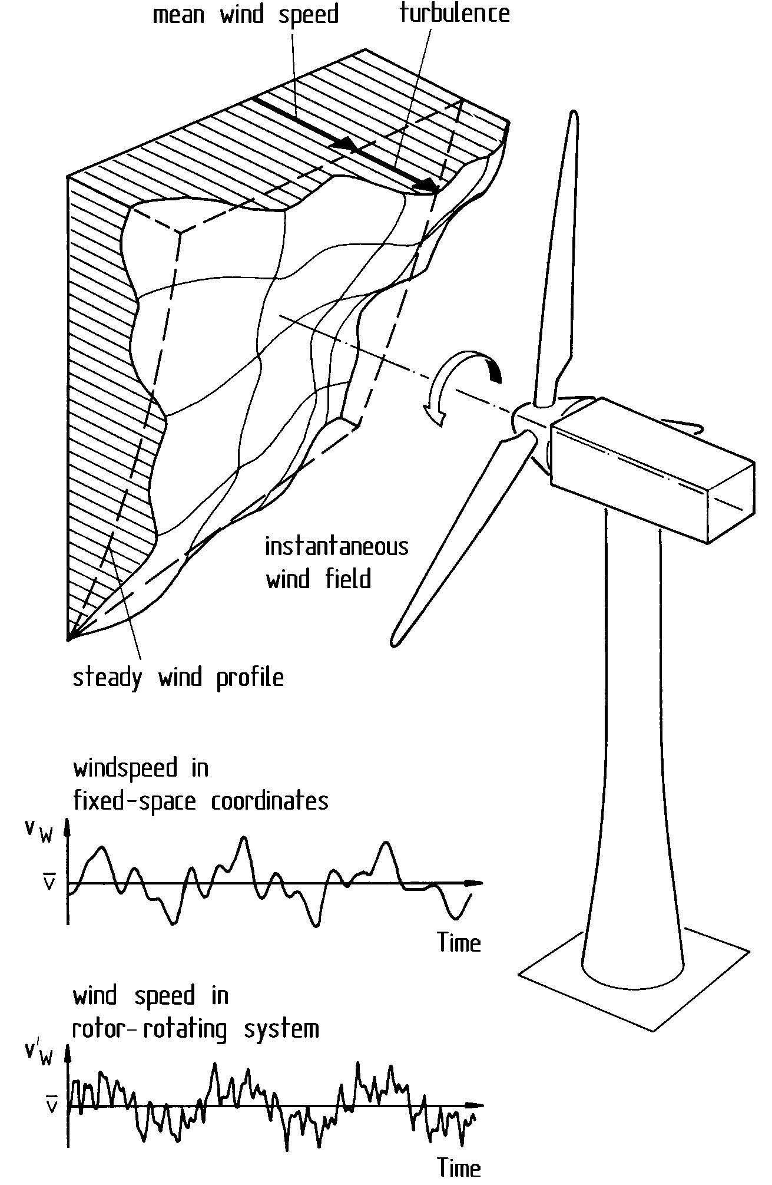
Introduction: Problem definition
Challenges in wind turbine control
Variation of wind speed
Etc
[E. Hau, 2006]

Slide 7
Literature Review
Wind turbines
Variation of wind speed
Etc
[E. Hau, 2006]

Slide 8
Literature Review: Research Objectives
Main Objective
Specific Objectives
1.
2.
3.

Slide 9
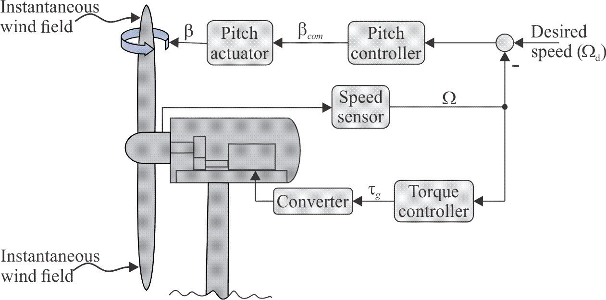
Methodology
Wind turbines
Variation of wind speed
Etc
[Njiri, Söffker, 2016]

Slide 10
Expected Outcomes
Wind turbines
Variation of wind speed
Etc

Slide 11
Expected Outcomes
Budget
 | Item | Description | Cost per unit (KShs) | Total Cost (KShs)
1.
2
Total

Slide 12
Expected Outcomes
Time plan
(Put your Gantt chart here)

Slide 13
Conclusion
Wind turbines
Variation of wind speed
Etc

Slide 14
Thank you for your attention.

